Slide 1
The Odyssey
A long voyage by Homer

Slide 2
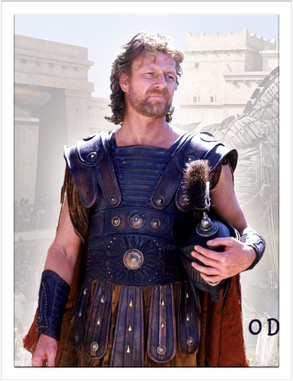
Odysseus
The model Epic Hero

Slide 3

An Epic Hero
A larger than life figure who embodies traits that the culture values
Physical strength
Bravery
High birth
Fame
Effective skills as a leader and in battle

Slide 4
Odysseus' Strengths
Courageous
Witty
"Deep heart"

Slide 5
Odysseus' Weaknesses
Curiosity
Cocky

Slide 6
Odysseus' Background
Laertes' son
From the island of Ithaca - off the coast of Greece
Famous for his guile (craftiness)

Slide 7
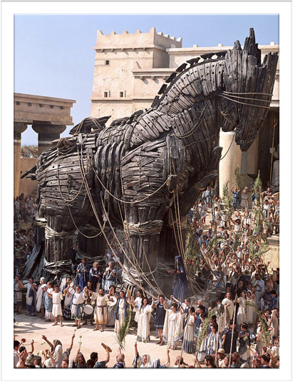
Sailing from Troy
Ten Years Later

Slide 8
Sailing from Troy - a summary
Alcinous, ruler of Phaeacia, provides a ship to Odysseus in return for the story of his adventures.
Odysseus' men looted, enslaved women, drank, and slaughtered cattle and sheep.
His men were rebellious and did not listen to Odysseus when he ordered then to return to the ship.
The Cicone Army came on horseback and killed 6 rows of men per ship and the Greeks mourned greatly for the death of their men.

Slide 9
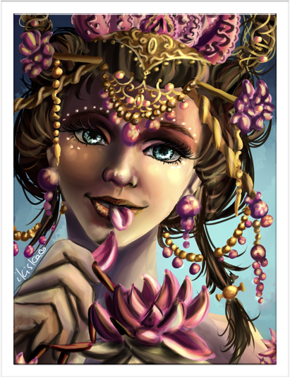
The Lotus Eaters
Storms lasting three days
Ten days drifting at sea
They arrive at the coastline of the Lotus Eaters

Slide 10
The Lotus Eaters - a summary
Zeus sent a vicious storm upon Odysseus' ships
Almost home, and near Melea, a gale drove them to the Land of the Lotus-Eaters.
Odysseus sent two men and a messenger to learn about the natives.
The three men ate from the lotus flower and then no longer cared to return to their homeland.
Odysseus forced the men back to the ship

Slide 11
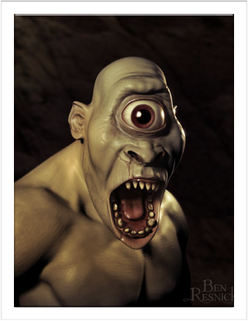
The Cyclopes
Odysseus meets Polyphemus - son of Poseidon.

Slide 12
The Cyclops - a summary
Odysseus is clever enough to see through his opponent's trickery and outwit him in return
Odysseus' curiosity leads him to disregard his mens' good advice
Odysseus and his men get trapped by the Cyclopes and he must come up with a strategy to escape.
Odysseus shows great cleverness and courage by blinding the Cyclopes with a spear made from an Olive tree.
Odysseus gets cocky at the end and taunts the Cyclopes as they escape.

Slide 13
The Cyclops Continued
The Cyclops, Polyphemus, prays to his father, Poseidon and curses Odysseus
Odysseus displays curiosity and boastfulness - as weaknesses
Odysseus displays cleverness, leadership, and bravery - as strengths

Slide 14
Greeks Value
An ordered society
Hospitality
The gods

Slide 15
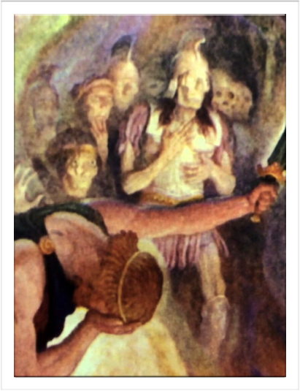
The Land of the Dead
Odysseus must confront the blind prophet, Tiresias

Slide 16
The Sacrifice
Odysseus performs the sacrifice he was told to do by Circe - to reach the blind prophet, Tiresias.
Tiresias was to tell Odysseus his future.

Slide 17
First - The Spirit of Elpenor
Elpenor's spirit asks Odysseus to burn Elpenor's body and build a memorial for him on the shore of Aegean Island.
Elpenor asks Odysseus to put his personal oar on top of the heap of stones. - This suggests that his spirit will be able to find peace once he has a proper burial.
Odysseus weeps and promises he will honor his request

Slide 18
Second - The Spirit of Anticlea
Odysseus meets the spirit of his dead mother - who was still alive when he took ship for holy Troy
Odysseus weeps.

Slide 19
Third - The spirit of Tiresias
Tiresias indicates that Odysseus can overcome Posidon's wrath if Odysseus focuses on his task and disciplines both himself and his crew.
Odysseus can return home only if he practices self-restraint.
Tiresias specifically tells him to avoid Helio's cattle - if he doesn't he will face destruction for his ship, loss of men, trouble at home.

Slide 20
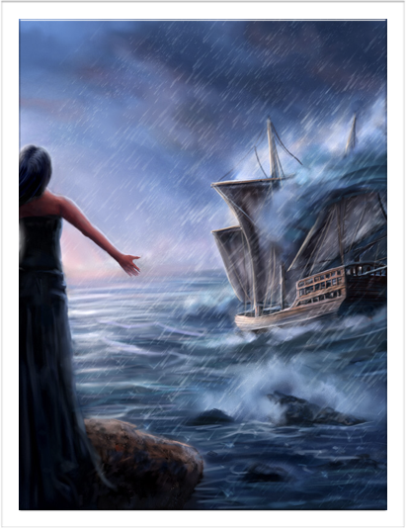
The Sirens
Sailors are lured in by their singing and then left to die at sea.
Loyal companions (crew) see them through this danger.

Slide 21
Odysseus knew his lack of self-control so he asks his crew to tie him to the mast of the ship
Odysseus put wax in his men's ears so they could not hear the Sirens.
The men peacefully and respectfully ignore Odysseus' request to 'Untie me!' and show great loyalty to their leader.

Slide 22
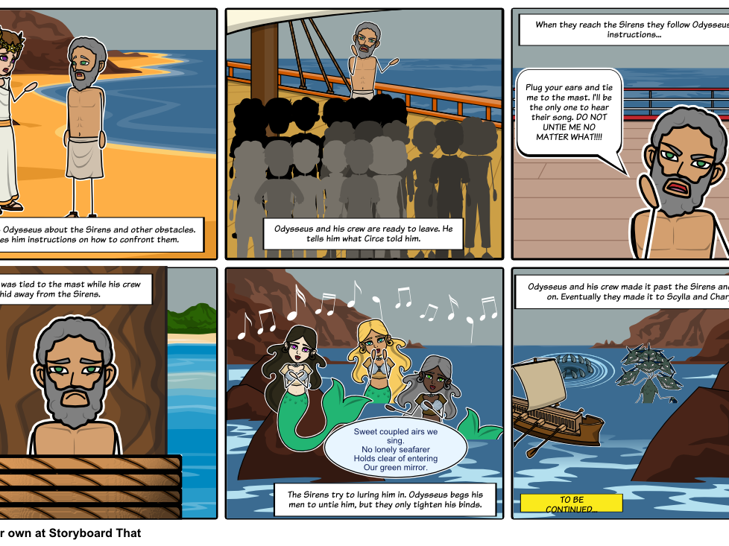

Slide 23
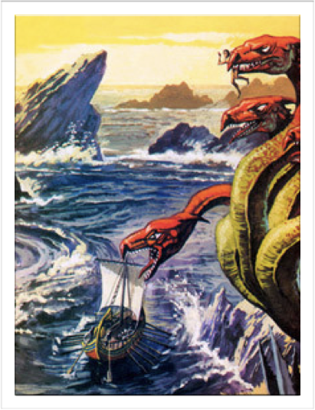
Scylla and Charybdis
Scylla appears as a sea-monster opposite the whirlpool, Charybdis

Slide 24
Odysseus as seen as a leader who gives clear orders
Odysseus loses 6 of his men to the Scylla
Odysseus shows great care and compassion for the loss of men

Slide 25
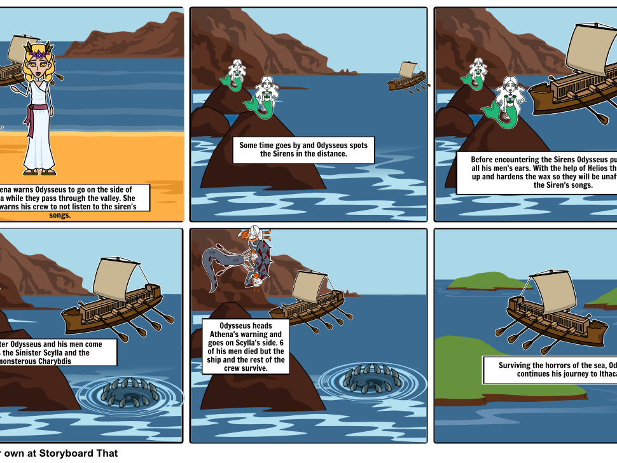

Slide 26
The Cattle of the Sun God

Slide 27
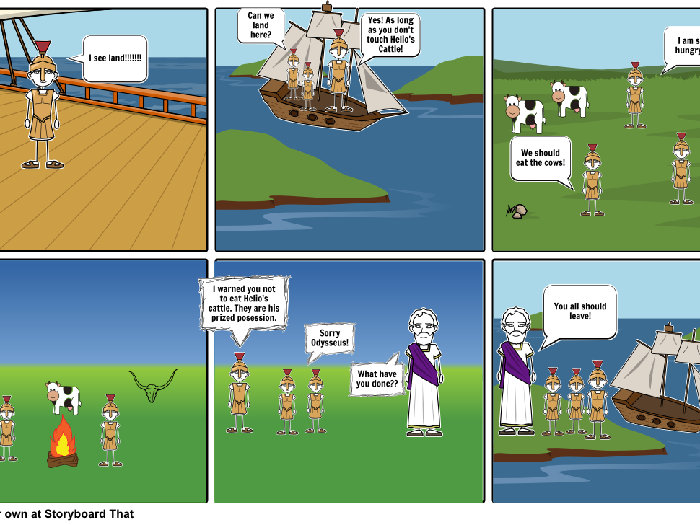

Slide 28
  "The Cattle of the Sun God". Storyboardthat. Clever Prototypes. 2017. Web. 1 February 2017
  "The Sirens". Storyboardthat. Clever Prototypes. 2017. Web. 1 February 2017.

